Slide 1

Building Learning for Sustainability into practice: streamlining policy into meaningful curriculum planning
Yvonne McBlain - Education Support Officer
Falkirk Children’s Services
Notes:
Welcome, introduce self. Ask audience to say hello to the their neighbours – say why you chose this workshop and what you hope to gain from it

Slide 2

What will we do?
Position this work within the wider policy landscape
Outline how we simplified/streamlined LfS
Look at long, medium and short-term planning of progressive LfS
Have a go at planning for your own LfS “bundle”
Consider how to make this planning responsive to your pupils and context
Notes:
Explain that what I’m sharing is the result of work done by me and J Jackson with input from practitioners and senior leaders. Has taken almost 3 years to develop.

Slide 3
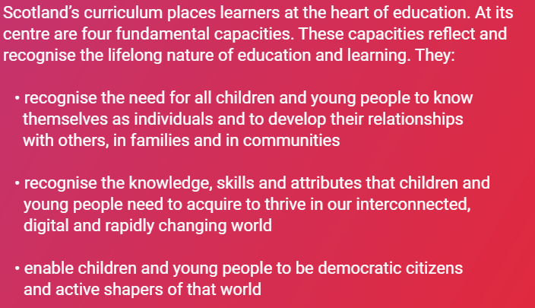
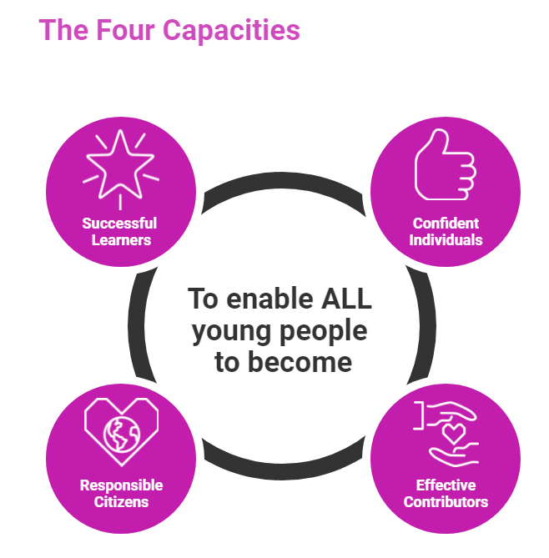

WHAT IS CFE ABOUT?
https://scotlandscurriculum.scot/
Notes:
Average high school is trying to reference and respond to over 200 education policies at any one time. Therefore need to streamline. I’ll begin by positioning the LfS work I’m sharing with you today within the wider policy landscape. – CfE – refreshed curriculum narrative captures the holistic nature of our national curriculum and its focus on citizenship, democracy and effective communities,

Slide 4
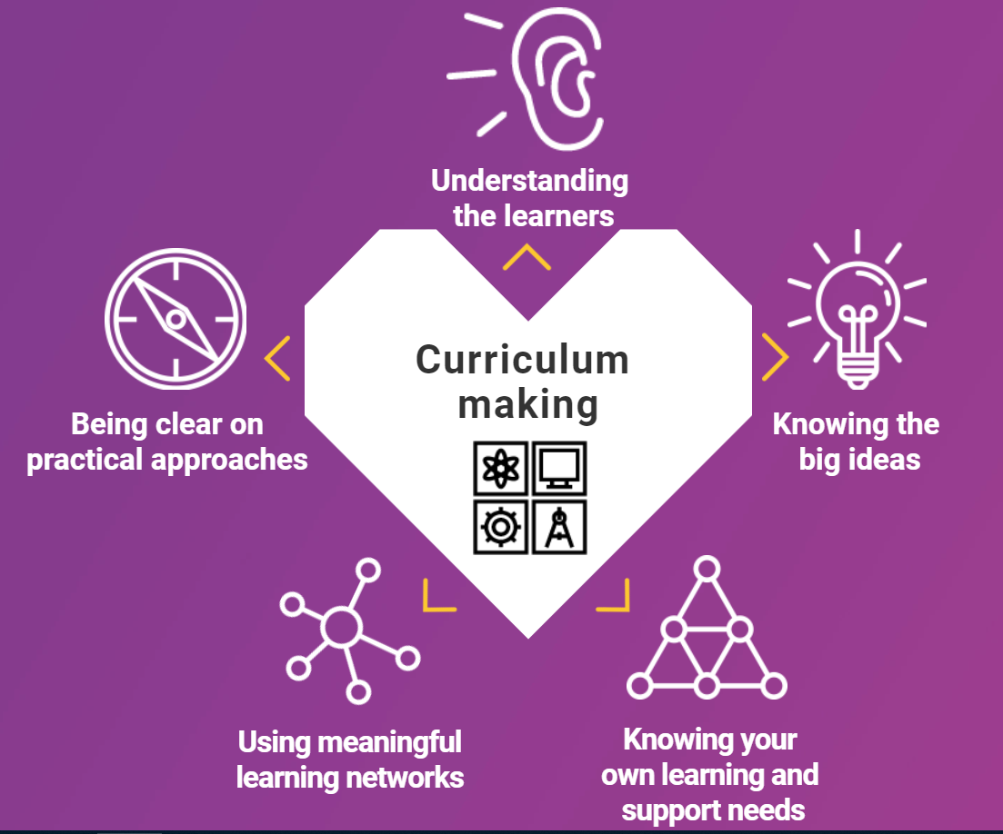
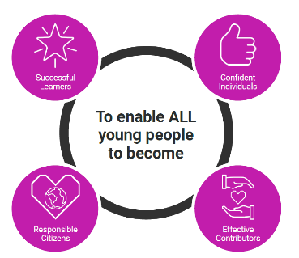
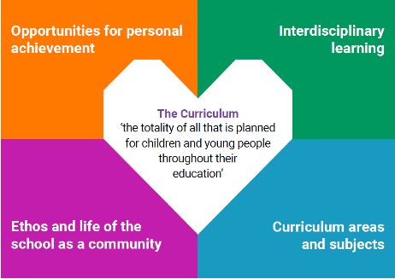
Scotland’s Curriculum
why | what | how
 | + entitlements
www.scotlandscurriculum.scot
Notes:
Slide from Ollie Bray (Strategic Director, Curriculum Innovation, Design and Pedagogy, Education Scotland) recent presentation capturing our curriculum explain why, what and how – our role as curriculum -makers

Slide 5

“All learners should have an entitlement to learning for sustainability….”
An effective whole school and community approach to LfS weaves together global citizenship, sustainable development education, outdoor learning and children’s rights to create coherent, rewarding and transformative learning experiences
Notes:
LfS policies – national plan under review at the moment. Pupils have entitlements within CfE with specific ones for LfS – 3 pillars in particular are supposed to feature in our practice regardless of the age, stage of pupils or our own subject specialisms

Slide 6
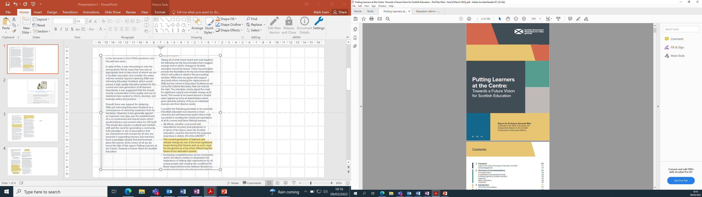
Notes:
Ken Muir's recently published report makes range of recommendations which you may be familiar with. The following slides were compiled by Mark Irwin, Education Scotland development officer for LfS to highlight how central to national next steps LfS will be.

Slide 7
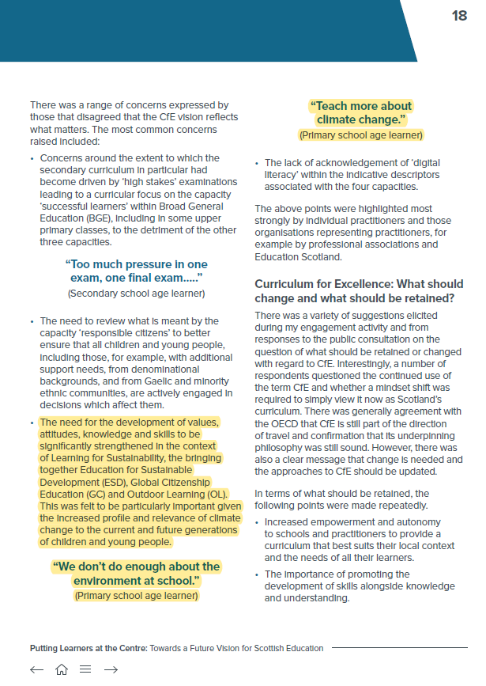
Views of CfE
The need for the development of values, attitudes, knowledge and skills to be significantly strengthened in the context of Learning for Sustainability, the bringing together Education for Sustainable Development (ESD), Global Citizenship Education (GC) and Outdoor Learning (OL). This was felt to be particularly important given the increased profile and relevance of climate change to the current and future generations of children and young people.
Notes:
CfE has values at its core and Muir's recommendations highlight the essential role which the 3 pillars of LfS play in its ongoing evolution. Contextualising the learning we provide within the breadth of LfS is given high priority. It also makes sense because we know how passionately our young people feel about climate change and other environmental and societal issues.

Slide 8
Views of CfE
“We don’t do enough about the environment at school.”
(Primary school age learner)
“Teach more about climate change.”
(Primary school age learner)
Notes:
These quotations from the document capture passion of CYP, but also highlight to us that no matter what kind of teacher we are, we need to make relevant connections between our teaching content and the local and global environmental issues which concern our pupils.

Slide 9
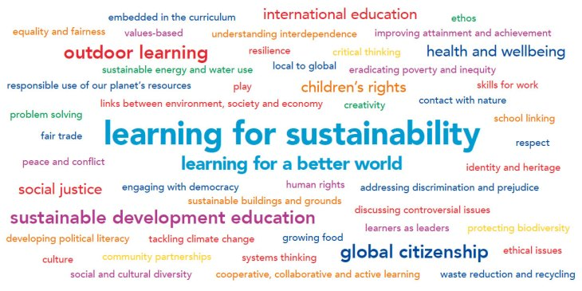
Notes:
So – a wide range of very high profile policy places LfS at the heart of our curriculum now and in the future. So - How to simplify from 47 words and phrases to coherence, consistency, progression, depth and breadth?

Slide 10
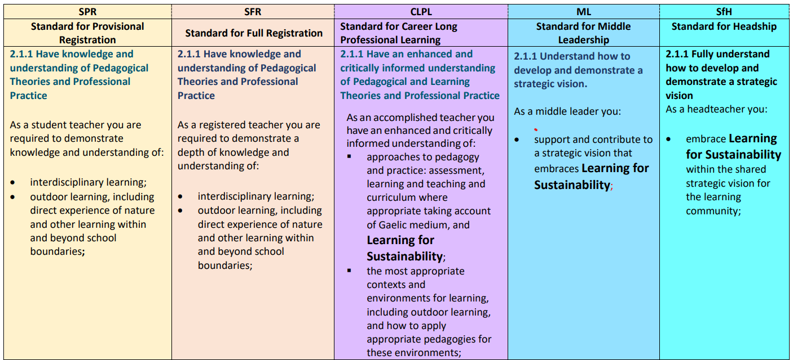
Learning for Sustainability - The General Teaching Council for Scotland (gtcs.org.uk)
Notes:
GTCS standards give us some guidance. LfS and outdoor learning are woven through all layers of our professional standards. This section of the LfS documents available from the LfS Hub demonstrates how pervasive LfS is in our education system. Link to LfS Hub is in the slide.
The Hub is a great place to find out a bit more about LfS with 4 sections – Explore, Engage, Enact and Embed and Connect. There are self evaluation tools as well as links to useful resources.

Slide 11

Notes:
So – our education is asking a lot of us teachers right now and it can all feel overwhelming. OECD recognises this and our overly complex education policy collection should be simplified over the next few years. So how did we streamline all of this into something manageable in daily practice

Slide 12
Curriculum for Excellence
Learning for Sustainability
Interdisciplinary Learning
Disciplinary Learning – experiences, outcomes, benchmarks
Notes:
Nesting and streamlining – a structure in our heads first – seeing the inter-relationships between the elements of curriculum – one plan which references all of these. A framework within which to plan for LfS as part of your curriculum over the long term – strategic curriculum planning developed in a collegiate way between staff

Slide 13
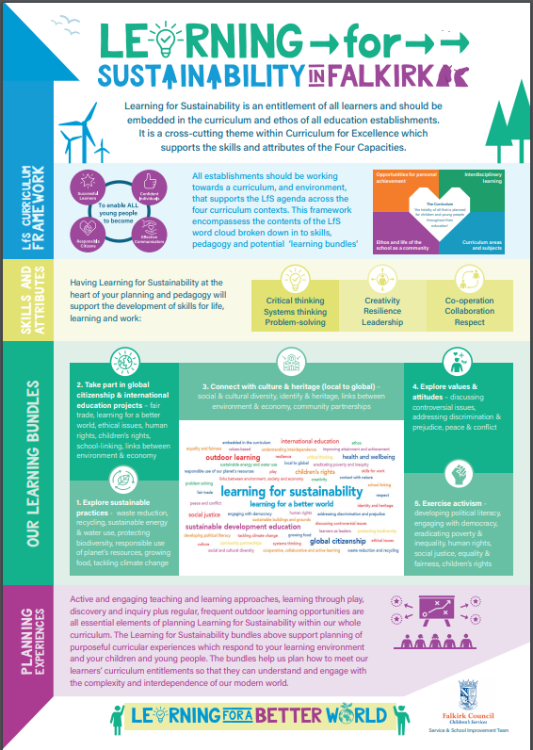

The Framework:
Poster
Plans
Processes
Professional Learning
Partners
More information from this Sway https://sway.office.com/0UffzVwsSs6R1fvu?ref=Link
Notes:
Describe framework structure – simple and clear

Slide 14

Let’s take a tour of the poster in detail
Notes:
Explain poster parts

Slide 15
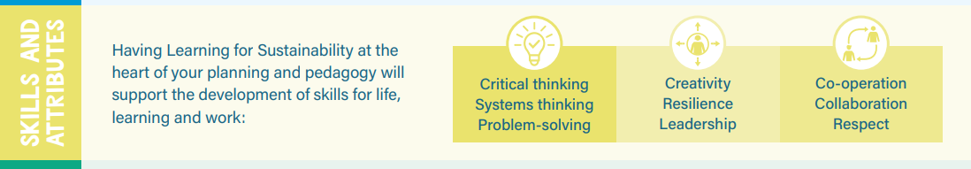
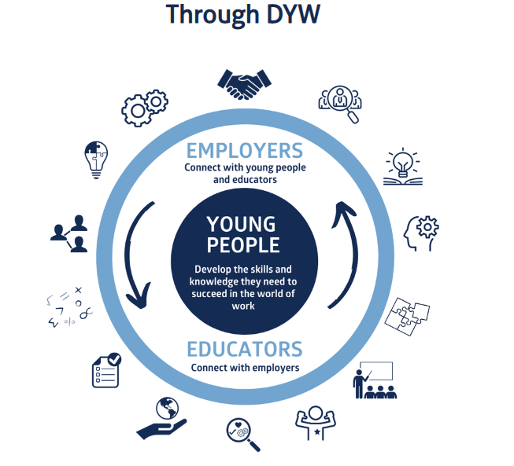
Next section - Identifies potential skills development
Notes:
Retains skills focus – links to DYW

Slide 16
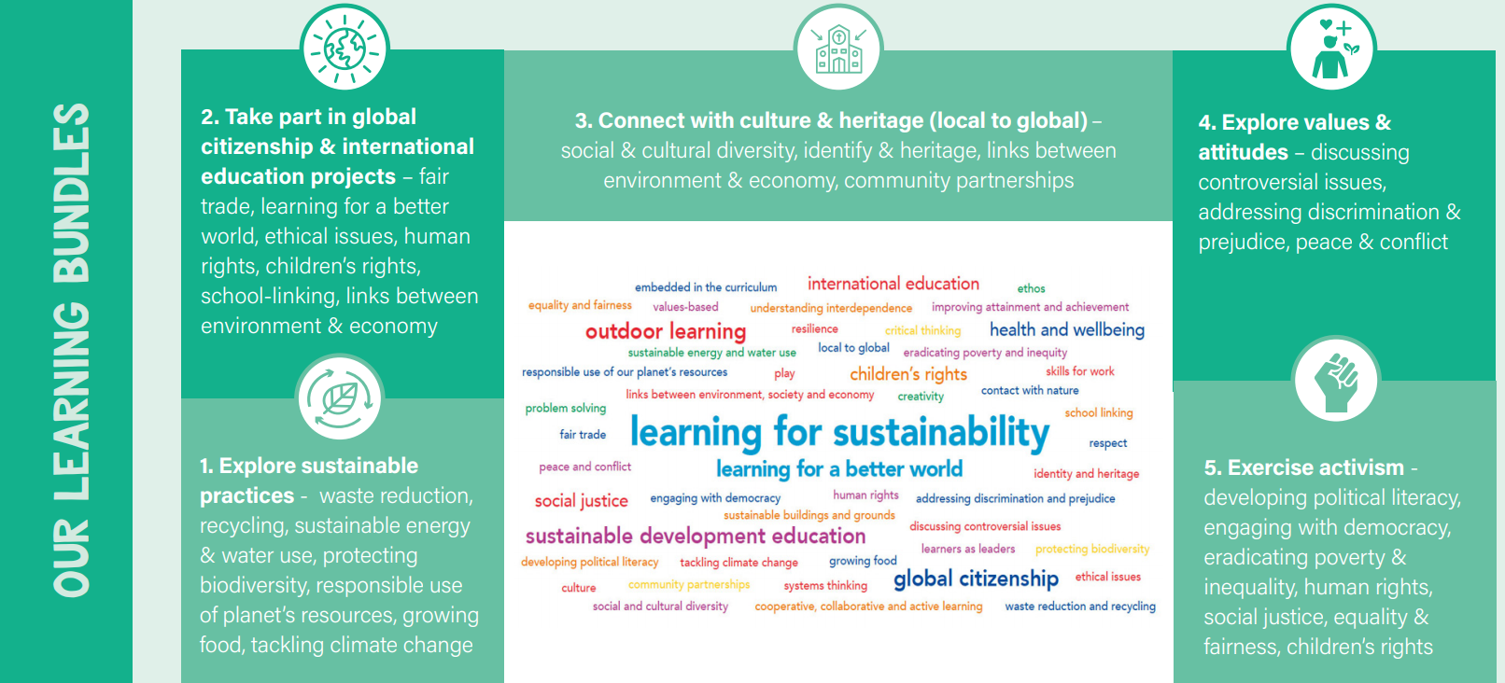
Overview of “the LfS bundles”
Notes:
From 47 to 5 curriculum purposes – broad and essential themes which need to be part of chn’s education. The entitlements

Slide 17
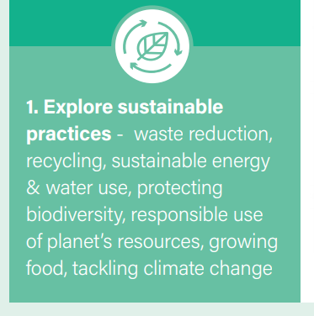
Bundle 1 Science Technologies Literacy– Explore sustainable practices
Notes:
Each bundle captures the broad curriculum purpose of this group of E & Os. Each bundle of E & Os has been put together in a starter plan which leaves room for practitioner interest, school syllabus, pupil interest, local, national and international events – such as COP 26

Slide 18

Bundle 2 – Social Studies (Modern Studies) RMPS HWB (Social Wellbeing)
Notes:
As you read each bundle descriptor you will see how these purposes could relate to both subject specific or IDL. You’ve probably had conversations about these issues with your pupils too.

Slide 19

Bundle 3 – Social Studies – History, Geography, Modern Studies Expressive Arts – Art & Design, Drama, Dance, Music HWB – Social Wellbeing Technologies – TCH developments in society & business (Business Studies)
Notes:
The bundles offer broad purposes which are rich enough to be interpreted in different ways over time. For example, in nursery or early level this bundle might be about spending time in the environment around your setting, following the children’s interests about their local area. In S1 your department might use this bundle to relate their local area – its industrial heritage, landscape, culture to national or global issues. This layering or spiral curriculum would then build breadth and depth of understanding while offering challenge and opportunities to apply pupil learning in an unfamiliar context.

Slide 20

Bundle 4 – RMPS HWB (Mental, emotional & social wellbeing) Modern Studies Literacy & English
Notes:
This is a bundle which we felt was not explicitly taught anywhere in our curriculum. It could be taught within the PSE element of a primary or secondary curriculum, or could be tailored within other subjects such as RMPS to tackle philosophical questions regarding how the Covid vaccines should be distributed globally. In sciences the focus could be on the immune system and in English and social studies the focus could be on communication and media – how the media are communicating or not communicating – in maths there is huge scope to examine information handling skills and data analysis

Slide 21
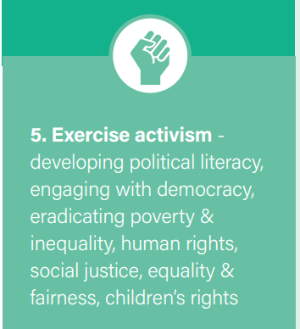
Bundle 5 – Modern Studies RMPS Literacy & English
Notes:
This bundle is another which is not explicitly taught within one discipline but could be used in a similar way within all subjects. It is particularly pertinent to English, social studies & RMPS is designed to equip our pupils as critically aware, politically literate and confident citizens

Slide 22
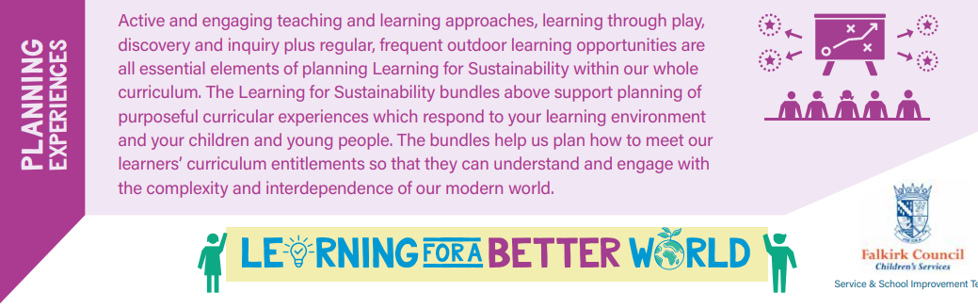
Description of pedagogy & planning
Notes:
Final section captures the foundational role of pedagogy in the teaching of these bundles. The essential role of taking learning out of the classroom and adopting active, engaging approaches which balance teacher and pupil-initiated learning.

Slide 23
Key Messages regarding IDL
Group E & Os together in ways which best suit learners.
Prioritise literacy, numeracy and health and wellbeing across the curriculum to ensure that all learners make the best possible progress.
Plan interdisciplinary learning(IDL) to make natural links across learning. Be aware of what is happening in other subjects and make connections.
Do not spend time on IDL which does not provide opportunities to apply and deepen learning or is contrived
When planning learning, teaching and assessment, E & Os are grouped or bundled together
Source: Education Scotland CfE A Statement for Practitioners from HM Chief Inspector of Education, August 2016
Notes:
YM – Here is some of the national guidance we received from HMIe in 2016 for IDL. You'll see that our LfS framework integrates the bundling or grouping of relevant subjects and E & Os advised in bullets 2 and 5.
By focussing on broad curriculum purposes in our LfS bundles, we aim to make the natural links across learning in bullet 3. Many secondary colleagues I work with say that this is a challenge because they don't know the E & Os of other subjects and therefore can't always identify these natural links. However, outdoor learning and LfS contexts help us see connections which are part of everyday life. For example, a geography field trip requires the skills of that discipline, but your pupils will also need to apply related literacy skills and potentially science enquiry skills to capture the information they need or fulfil your task or challenge. Bullets 2 and 4 offer direct advice about the need for us to plan IDL which enables our pupils to apply skills they have been taught in subjects or disciplines. This joint planning across secondary subjects to identify mutually beneficial opportunities for both outdoor learning and IDL recalls the recommendations of the Muir report - making sure that the content of our BGE and senior phase is rooted in reality rather than being dictated by the exam system.

Slide 24
Our Framework rationale?
Learning for Sustainability was & is integral to CfE
Conscious structuring of curriculum to ensure LfS entitlements
Supporting schools & practitioners with streamlining LfS into their curriculum planning – including assessment
Breadth, depth, progression - no gaps, no repetition
Balancing structure with flexibility, relevance and responsiveness to people and context
Enabling & encouraging participation, agency and empowerment
Notes:
Yvonne

Slide 25
So what could this look like in practice? And how does the planning of the learning look?

Slide 26
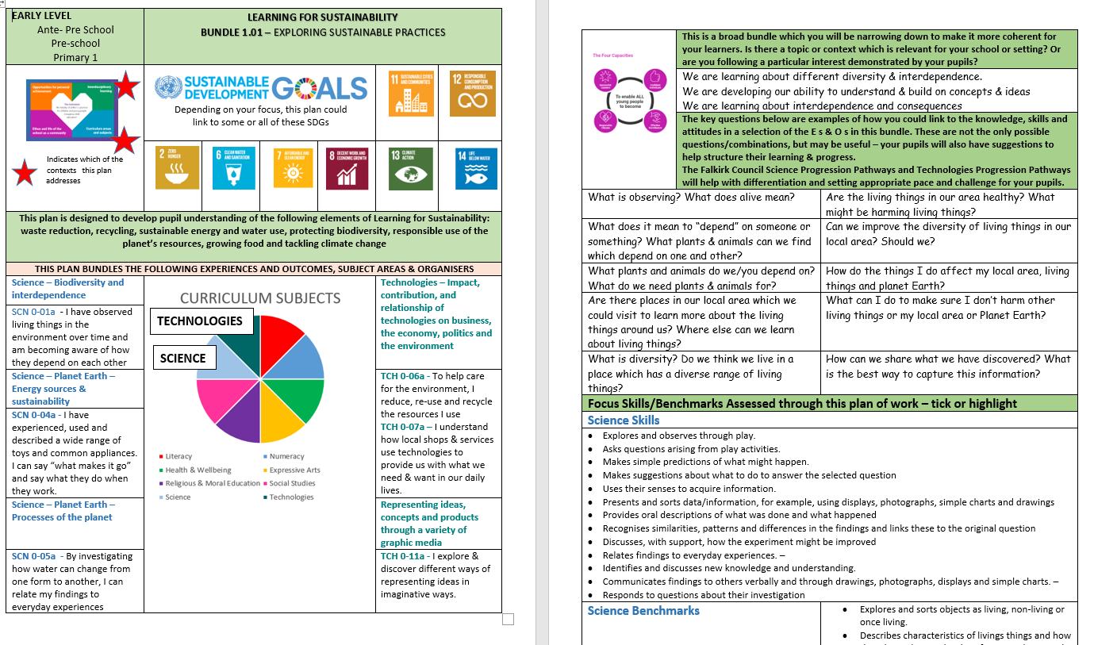
Notes:
Visual plans evolved from practitioner feedback. Layout is another way in which we try to streamline bureaucracy so that this format acts as a long-medium term planner. I’ll give you a brief tour and then we’ll take some time to look at the range of bundle plans in more detail

Slide 27

Let’s do some planning:
Planning with a bundle – agree which one you want to use
Plan the key questions you will use to enable your students to help lead the learning
Notes:
Working in groups of 4 – identify the key questions you would derive from the E & os. Note the types of learning activities which you think would support these

Slide 28
Reflecting on the planning task:
General comments?
What is your opinion about how these plans would enable pupil voice/participation in learning?
In what ways might you use these to promote progression of learning?
Notes:
Gather thoughts from each group

Slide 29
GTC Scotland GTCS professional guide for teachers professional-guide-Learning-for-Sustainabilty.pdf (gtcs.org.uk) GTCS self evaluation toolkit Self-evaluation Wheel: Learning for Sustainability | General Teaching Council for Scotland (gtcs.org.uk) What is LfS and what does it mean for me? Learning for Sustainability | General Teaching Council for Scotland (gtcs.org.uk)
Notes:
GTCS links

Slide 30
Further reading: A summary of learning for sustainability resources | Learning resources | National Improvement Hub (education.gov.scot) Learning for sustainability in action | Practice exemplars | National Improvement Hub (education.gov.scot) Impact of Learning for Sustainability on educational outcomes: summary - gov.scot (www.gov.scot) sci17_openinguplearningsust.pdf (education.gov.scot)
Notes:
LfS links

Slide 31
Contact Details
More information from this Sway https://sway.office.com/0UffzVwsSs6R1fvu?ref=Link
Or contact yvonne.mcblain@falkirk.gov.uk
Notes:
Further info from our Sway plus my email details

